Slide 1
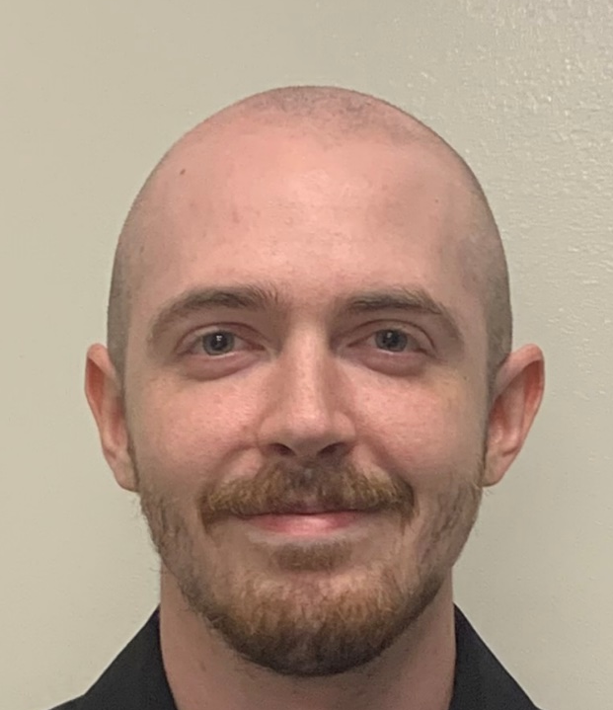
Optical Beacon Tracker for
Optical Wireless Communication
Group 4:
Seth Johnson (PSE)
Raymond Loudis (EE)
Blake Baez (CPE)
Committee Reviewers:
Dr. Kyle Renshaw
Mark Maddox
Justin Phelps
Sponsored by the Knight Vision Lab

Slide 2



Meet the Team
Seth Johnson
Photonic Science
& Engineering
Blake Baez
Computer Engineering
Raymond Loudis
Electrical Engineering

Slide 3

Meet Our sponsor

Slide 4
Motivation and background
Optical wireless communication (OWC) has existed for decades, however clear communications require precise alignment which is difficult to maintain whilst mobile.
The goal of this project is to build a device that can track an optical beacon while both the receiver and the beacon are mobile.

Slide 5

Overall Project diagram
Receiver System
Beacon System
Photodetectors
Beacon Illuminators
10˚
45˚
Receiver Gimbal
Beacon Motors

Slide 6
Project Goals
Basic Goals
Create a beacon with enough power and divergence to be detected up to 3 meters away whilst indoors
Create a receiver that can actively track the beacon whilst mobile, up to 3 meters away when indoors
Advance Goals
Track the beacon up to 1 km away whilst outdoors.
Stretch Goals
Track the beacon up to 10 km away in ideal weather conditions.
Transmit and decode a simple signal (like an SOS) from the beacon.

Slide 7

Project Objectives
Calculate the required optical output power for the beacon to be detectable by the receiver at a given distance.
Design the focusing, diverging, and collimating lens systems on the beacon and receiver.
Design a PCB for the beacon and receiver.
Design a power supply for the beacon and receiver respectively, capable of driving the light sources and gimbals/dc motor, as well as biasing the photodiodes.
Create a algorithms that enables the gimbals/dc motor to use outputs from the QPD, GPS, and IMU as inputs for positioning.

Slide 8
Project Specifications
Requirement | Specification | Description
Receiver FOV | 10-20 degrees | The viewing angle from the receiver
Beacon FOV | 40-50 degrees | The divergence angle of the beacon
Stationary track accuracy | 10-20 μRad | The accuracy of the system when stationary
Mobile track accuracy | 500-600 μRad | The accuracy of the system when mobile
Track loop without IMU compensation | 10-15 kHz | Signal processing loop without using an IMU
Track loop with IMU compensation | 100-200 Hz | Signal processing loop while using an IMU
Receiver and Beacon weight | Less than 5kg Each | The receiver and beacon must weigh less than 5kg respectively
Indoor functional distance | 2-3 meters | Functional distance while indoors
Outdoor functional distance | 1-1.5 kilometers | Functional distance while outdoors
Battery life | 30-60 minutes | How long the system will be able to run on battery supply
GPS Accuracy | 2-3 meters | Accuracy of the GPS system without the optical beacon
Orange Rows are
demonstrable specs.

Slide 9
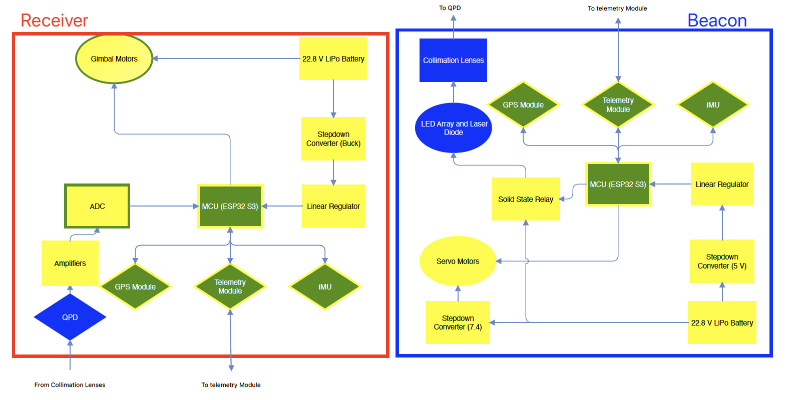
Hardware Block diagram

Slide 10
Optical design and hardware selection

Slide 11
Optical Diagram
850 nm filter
with hole in the center
Fiber Output Expander
Diverging Lens
Collecting Lens
1550 nm LD
Dichroic
Mirror
SMF Optical Fiber
Quadrant
Photodiode
Fiber Output
Coupler
Collimator Lens
SMF Optical Fiber
Transmissive
Diffusor Plate
1550 nm detector
With 1550 nm filter
850 nm LED array

Slide 12
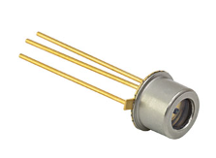
Photodiode selection
Company | Product ID | Responsivity (A/W) | MDP (nW) | Rise Time (ns) | Cost
Thorlabs | FGA015 | 0.95 | 0.44 | 0.3 | $65
Thorlabs | FGA01FC | 1.00 | 0.15 | 0.3 | $174.62
Edmund Optics | #55-754 | 0.95 | 0.15 | 0.3 | $95
Edmund Optics | #62-271 | 0.95 | 0.05 | 10 | $100
Excelitas Technologies | C30645EH | 0.93 | 0.18 | 40 | $318.15
Excelitas Technologies | C30662L -200 | 0.94 | 3 | 0.3 | $203.7
FGA015
InGaAs Photodiode

Slide 13
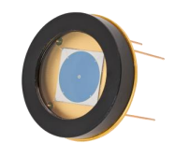
The quadrant photodiode
Quadrant Detector
ϕ200μm laser cut hole on chip
MDP of 0.15nW
SPOT-9D-0

Slide 14



Calculating incident optical power and required beacon output power
$$P_{inc}=P_{o}∙\frac{A_{d}}{A_{B}}$$
$$A_{d}=π{\left(\frac{D_{d}}{2}\right)}^{2}$$
$$A_{B}=π{\left(d∙\tan\left(\frac{θ_{div}}{2}\right)\right)}^{2}$$
Outdoors
$$d = 1 km$$
$$θ_{div}=45°$$
$$D_{d}=1 inch$$
$$A_{d}=π{\left(0.0127 m\right)}^{2}$$
$$A_{B}=π{\left(414.2 m\right)}^{2}$$
$$P_{inc}=P_{o}∙9.4×{10}^{−10}$$
Indoors
$$d =3 m$$
$$θ_{div}=45°$$
$$D_{d}=1 inch$$
$$A_{d}=π{\left(0.0127 m\right)}^{2}$$
$$A_{B}=π{\left(1.24 m\right)}^{2}$$
$$P_{inc}=P_{o}∙0.0001$$
With our chosen photodiode and QPD, the output power of the beacon can be no less than 450mW at 1550nm, and no less than 164mW at 850nm.

Slide 15
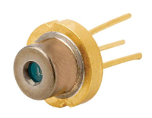
Laser selection
Company | Product ID | Output Power (W) | Threshold Current (A) | Fast Divergence Angle (deg) | Unit Cost
Advanced Photonix | CVLL 95-90 | 10 | 1 | 24 | $236
Thorlabs | FPL1055T | 0.3 | 0.75 | 23 | $424
Thorlabs | L1550G1 | 1.7 | 5 | 28 | $355
CVLL 95-90
1550nm Laser Diode

Slide 16
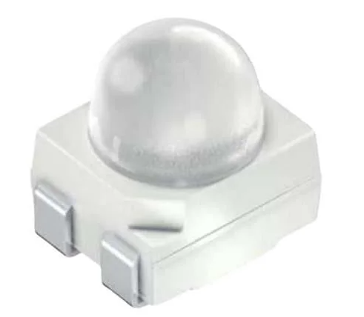
LED selection
Company | Product ID | Output Irradiance (mW/sr) | Driving Current (mA) | Viewing Angle (deg) | Unit Cost
Lumileds | L1I0- 0850060200000 | 1150 | 1000 | 60 | $4.04
ams OSRAM | SFH 4258S | 100 | 100 | 30 | $1.10
Vishay | VSMY98545ADS | 380 | 1000 | 45 | $5.98
Wurth Elektronik | 15427285BA240 | 160 | 1000 | 120 | $2.46
Vishay | VSMY12850 | 16 | 70 | 80 | $0.71
Broadcom | ARE1- 89D0-00000 | 600 | 1000 | 90 | $4.76
SFH 4258S
850nm LED
In a 5x5 array, the chosen LEDs will emit a total of 2500 mW/sr.
This roughly equates to 535mW within the viewing angle

Slide 17
Lens selection
Each lens was tested both physically and in zemax. And they have the Edmund Optics NIR II AR coating which provides 98%-99% transmission at 850nm and 1550nm wavelengths.
Collecting Lens: 1” diameter, f = 16mm
Diverging Lens: 25mm diameter, f = -100mm
Fiber Output Expander: 6mm diameter, f = -6mm
Array Collimator: 30mm diameter, f = 30mm

Slide 18
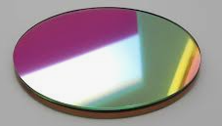
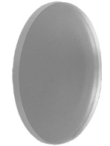
Dichroic Mirror and Transmissive diffuser
87-040
Dichroic Mirror
1" diameter
99% reflection at 850nm
99% transmission at 1550nm
ED1-C20 Transmissive Diffuser
1" diameter
20-degree divergence
90% transmission

Slide 19
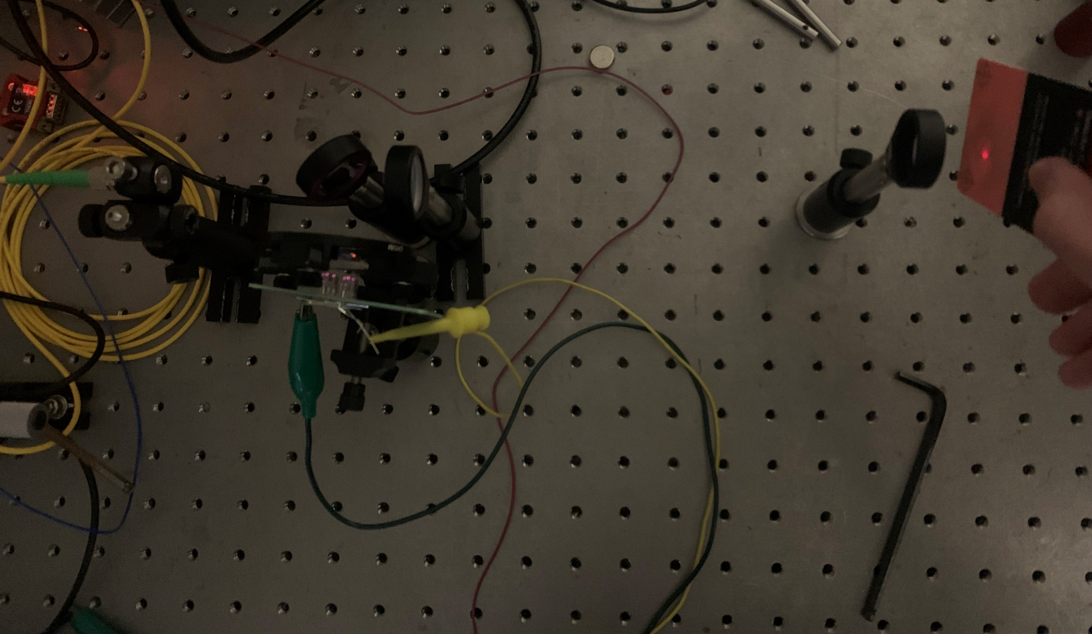
Testing the optical setup

Slide 20
Hardware Selection and PCB Design

Slide 21
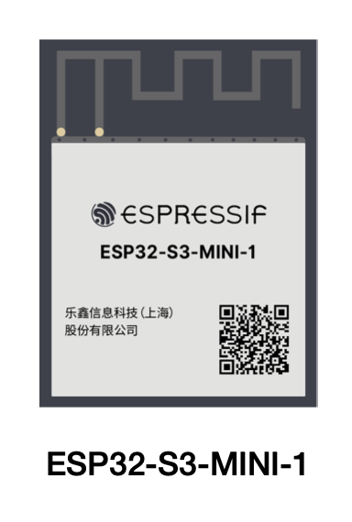
Mcu selection
Brand/Type | Processor | Flash Memory | SRAM | Communication Protocol Channels
ESP-32 | Dual-core Tensilica LX6 microprocessor, up to 240 MHz | 4 MB | 520 KB | 3 UART, 3 SPI, 2 I2C, 1USB
Arduino Due | Ateml SAM3X8E ARM Cortex-M3, 84 MHz | 512 KB | 96 KB | 4 UART, 2 SPI, 1 CAN, 1 USB
Teensy 4.0 | ARM Cortex-M7, 600 MHz | 2 MB | 1 MB | 7 UART, 3 SPI, 3 I2C, 1 I2S, 1 CAN, 1 USB
Raspberry Pi Pico | Dual-core ARM Cortex-MO+, 133 MHz | 2 MB | 264 KB | 2 UART, 2 SPI, 2 I2C, 1 USB
ESP 32 S3 Mini N8 | Dual-core Xtensa LX7, 240 MHz | 8 MB | 512 KB | 3 UART, 2 I2C, 2 I2S, 4 SPI, 1 USB

Slide 22
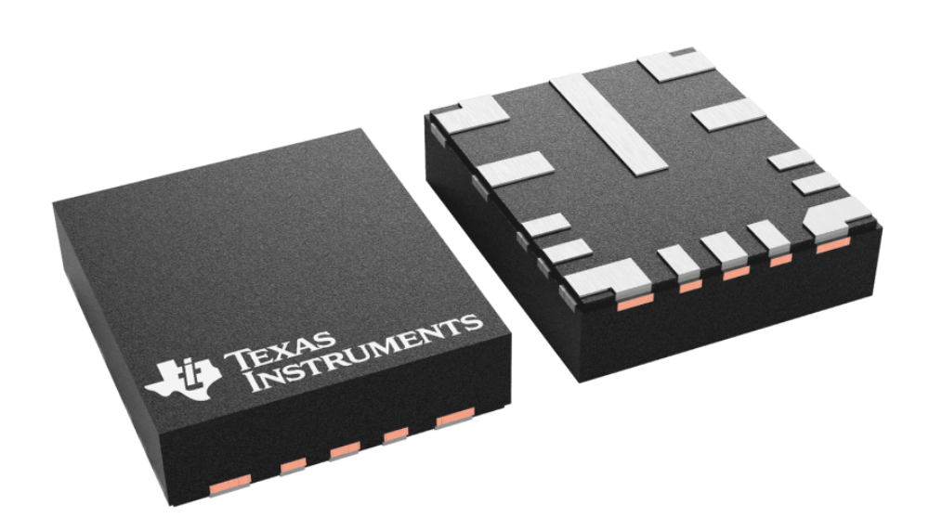
Voltage Regulator selection
Regulator | Type | Input Voltage Range (V) | Output Voltage Range (V) | Max Output Current (A) | Max Output Power (W)
MC34063A | Boost/Buck | 3 - 40 | 1.25 – 40 | 1.5 | 60
LM2675 | Buck | 6.5 - 40 | 1.23 – 37 (adj) 3.3, 5, 12 (fix) | 2.2 | 81.4
LMQ61460 | Buck | 3 - 36 | 1 – 34 | 6 | 204
LM317 | Linear | 3 - 40 | 1.25 - 37 | 1.5 | 55.5
TLV75801P | Linear | -.3 – 6.5 | 0 – 6.8 | .5 | 3.4
TLV761 | Linear | 2.5 - 16 | .8 - 13 | 1.6 | 20.8

Slide 23
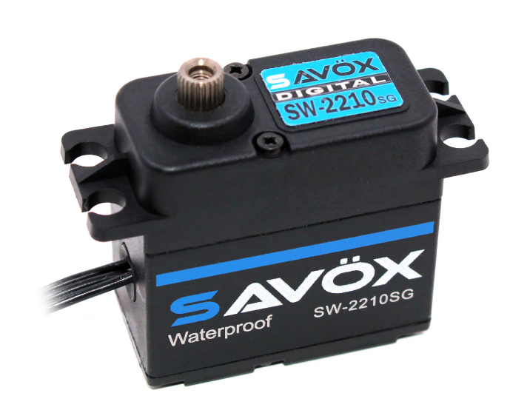
Servo motor selection
Servos | Torque (kg/cm) | Running Current (mA) | Operating Voltage (V) | Weight (g) | Speed (degree/sec)
Savox SW2210SG | 7 | 220 | 6 – 7.4 | 79 | 545
Power HD-1501MG | 15.5 | 400 - 500 | 4.8 - 6 | 60 | 375
TowerPro MG995 | 11 | 170 | 4.8 – 6.6 | 55 | 300

Slide 24
Gimbal
Gremsy T3V3
  The KVL donated this gimbal
It was within budget to purchase something else, however this was chosen for:
  High stability and smooth motion control
  Ease of integration with GPS modules
  Adaptable mounting system
  Lightweight compared to strength

Slide 25
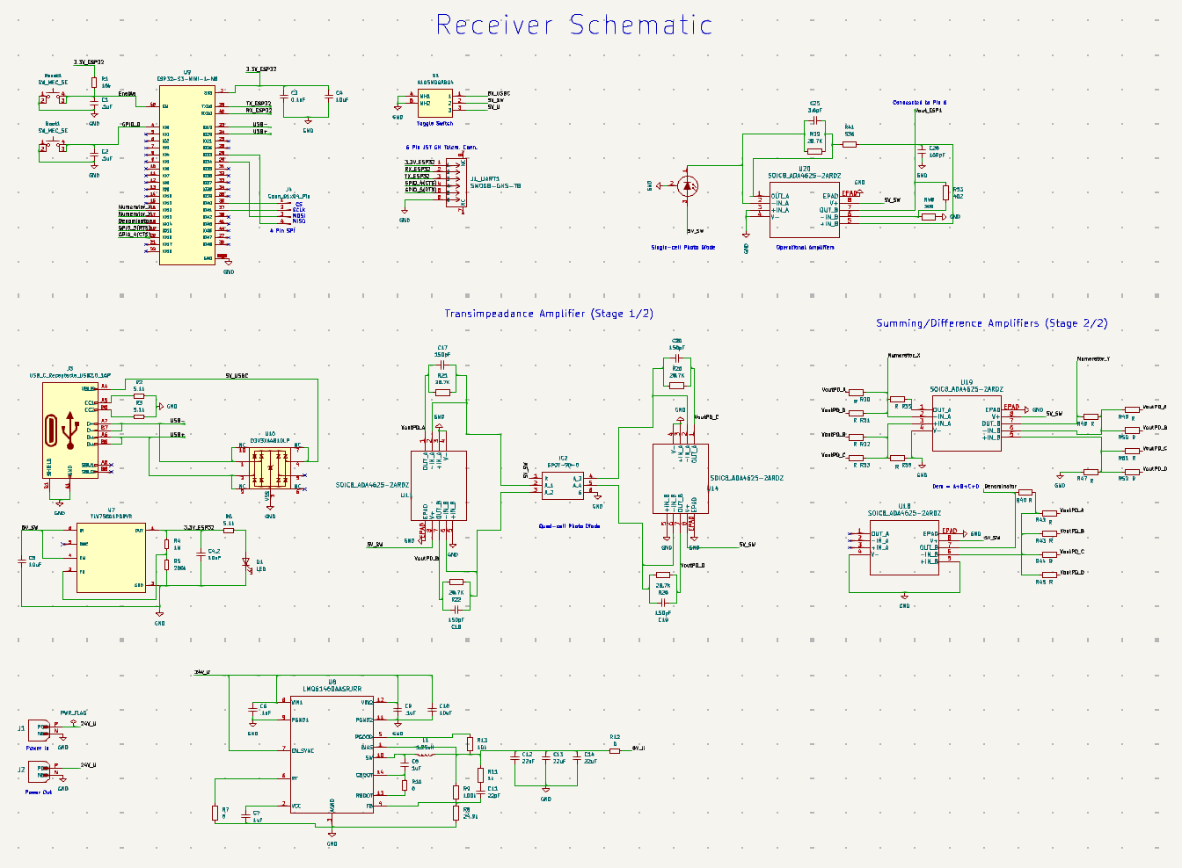

Slide 26
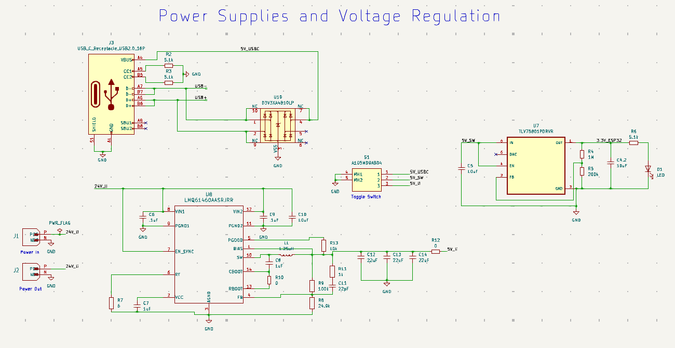
PS Selection and regulation (Receiver)

Slide 27
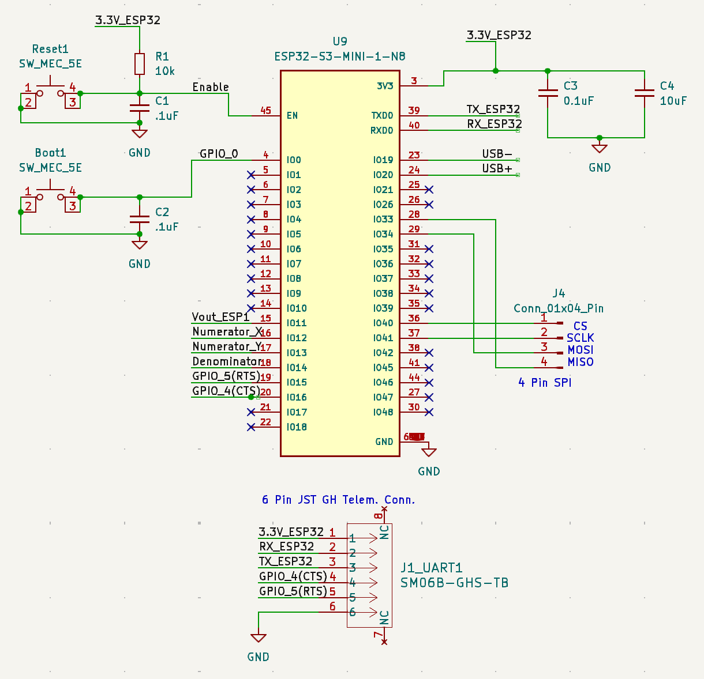
Mcu Connections (Receiver)
TX and RX pins are used for the 6 pin UART connection for a telemetry module, the CTS and RTS will be assigned to pins IO14 and IO15 respectively.
Pins IO33 and IO34 are used for MISO and MOSI while IO36 and IO37 are used for CS and SCLK, all combine to create a 4 pin SPI connection.
Pins IO12, IO13 and IO14 will receive the analog signal from the QPD and send it to ADC 2
The enable pin is connected to the reset button with a pull up resistor while GPIO 0 is connected to the boot button.

Slide 28
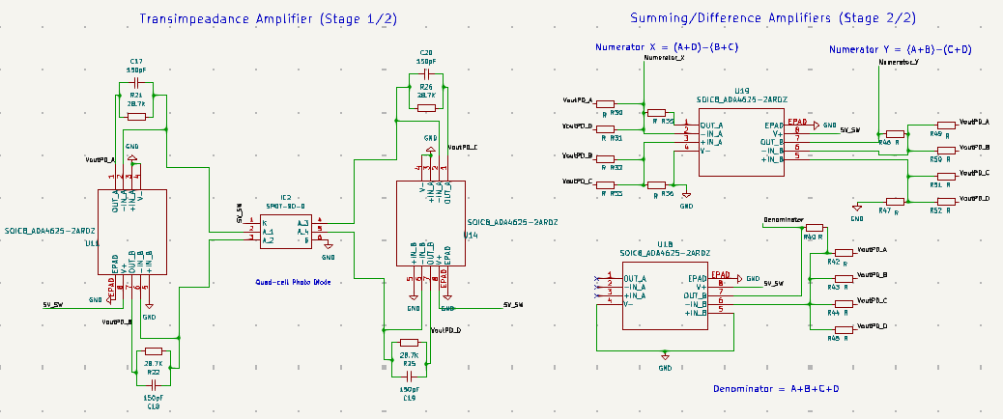
Quad-cell photodiode

Slide 29
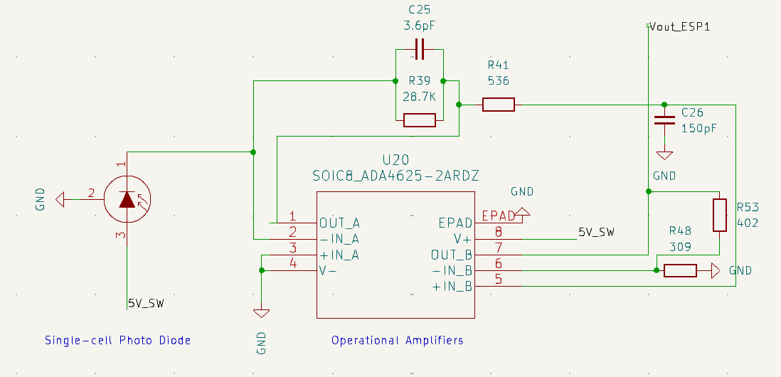
Single-cell Photodiode

Slide 30
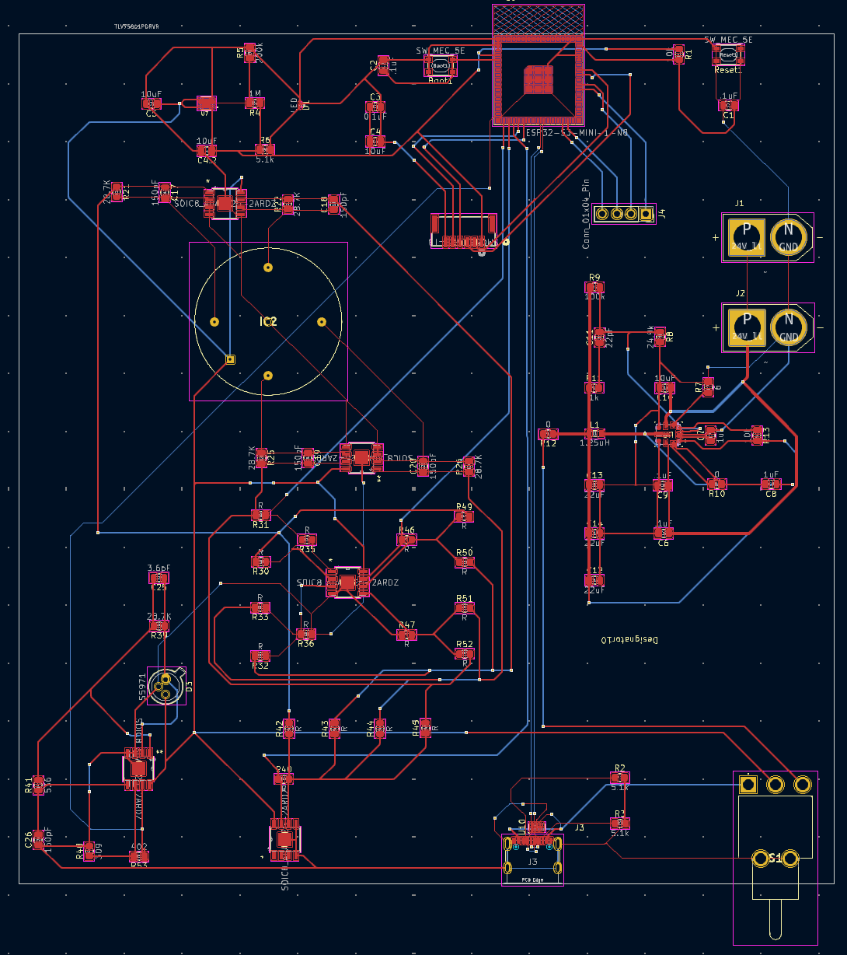
PCB layout (receiver)

Slide 31
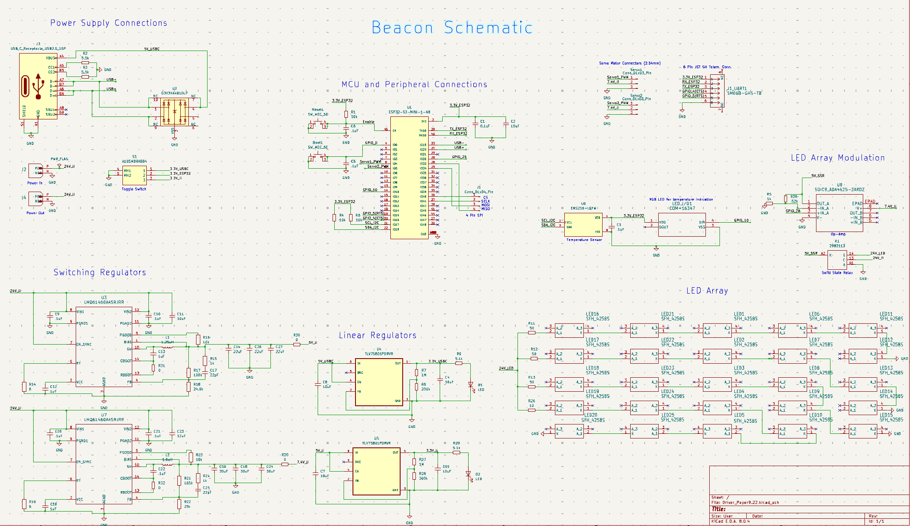

Slide 32
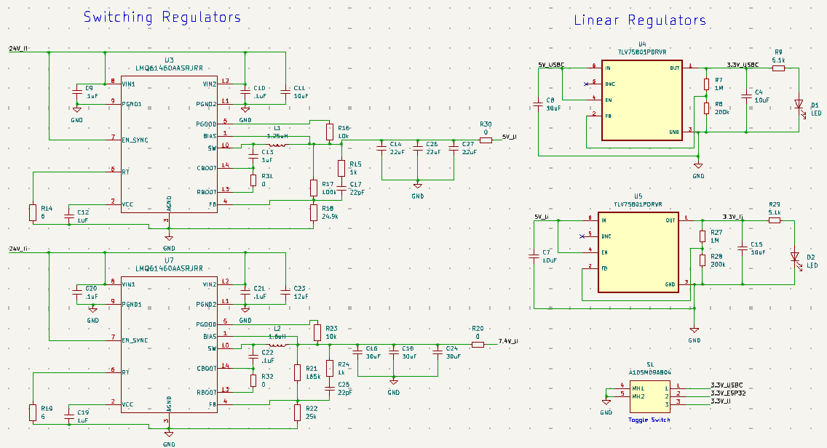
PS Selection and Regulation (Beacon)
Previously we used the toggle switch to control the power supply to the entire board. However, here we implement the toggle switch to only control power to the ESP32. For this reason, we will be using a second linear regulator. One for the battery input and the other for USBC input.
Additionally, we will be using a second switching regulator to power our servo motors at 7.6 V

Slide 33
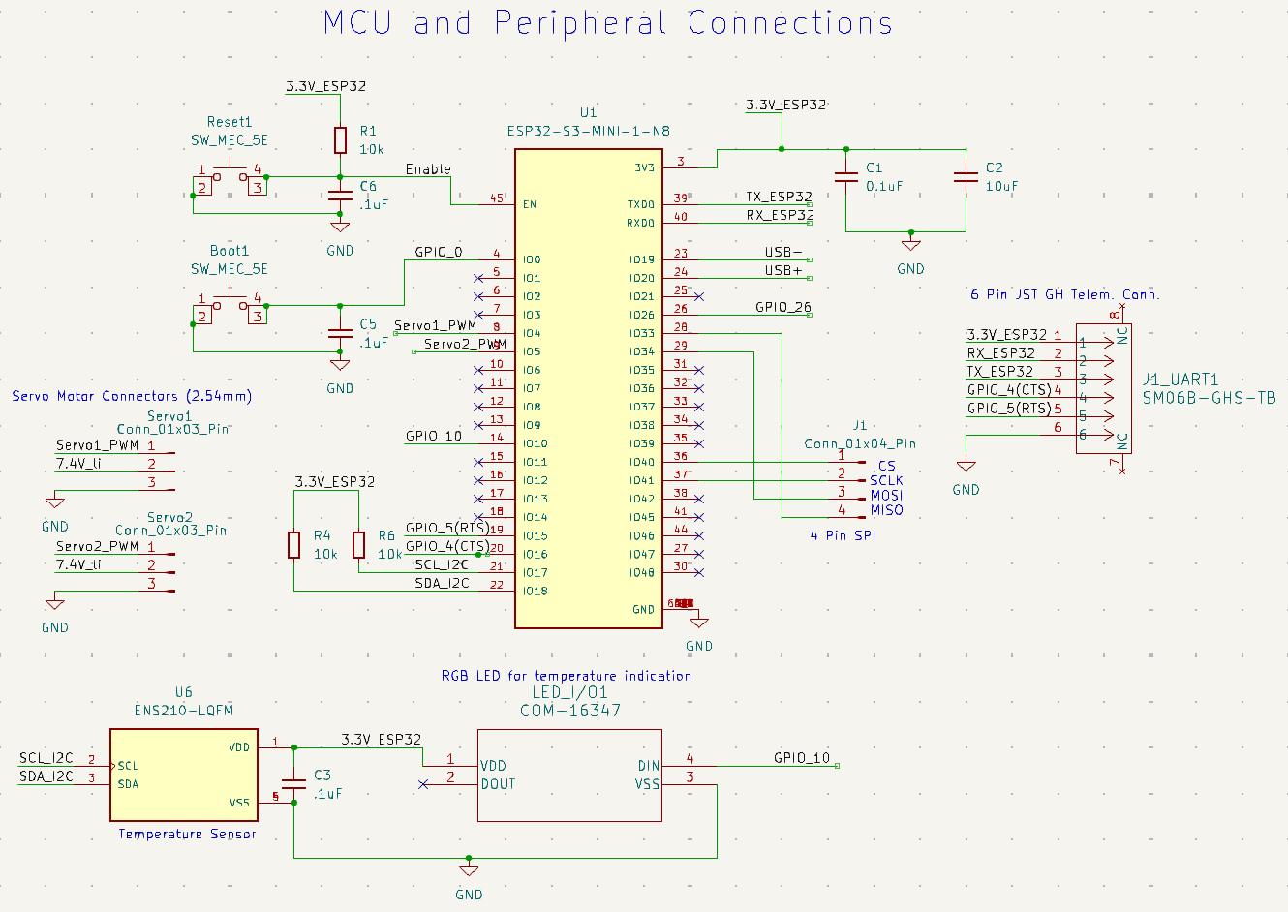
MCU Connections (Beacon)
Like before we will be using the same pins for our UART and SPI connections and our reset and boot buttons.
Contrastingly we will be adding an I2C connection to a temperature and humidity sensor. If temperature or moisture exceeds acceptable levels an RGB LED will indicate the issue and its severity.
Another addition is the two 3 pin connectors for our servo motors. One of the pins from each connector will supply 7.6 V to the motors while another relays the PWM signals from the MCU and the last pin is used for grounding.

Slide 34
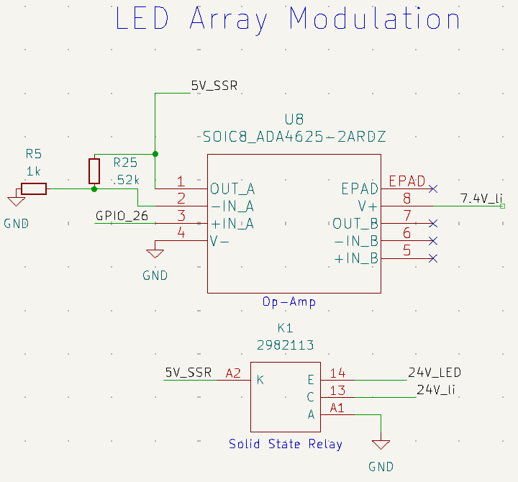
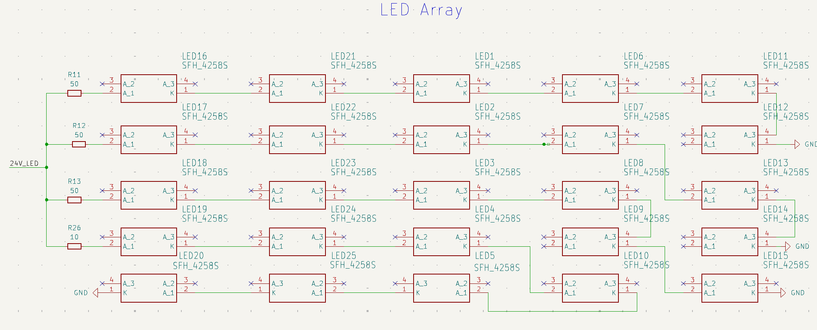
LED array & Modulation
25 total LEDs in total. Four series runs in parallel.
Modulated with a solid-state relay.
Notes:
For our LED array we will be using 25 LEDs with three series runs of 6 and another of 7, all 4 series are connected in parallel. These LED’s will be powered directly from our battery supply and will be controlled using a solid-state relay. The relay requires a 5 V signal which will come from the MCU. Because the esp32 is only capable of emitting a 3.3 V signal we will be using an operational to boost the signal to 5V.

Slide 35
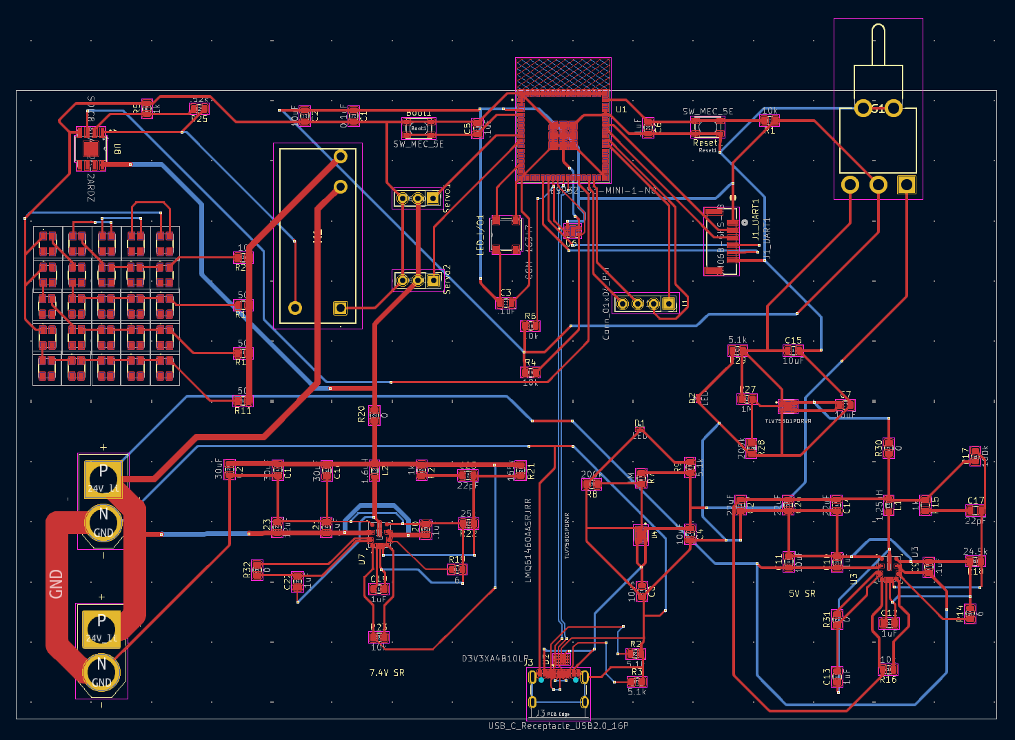
PCB layout (receiver)

Slide 36
Software selection and design

Slide 37

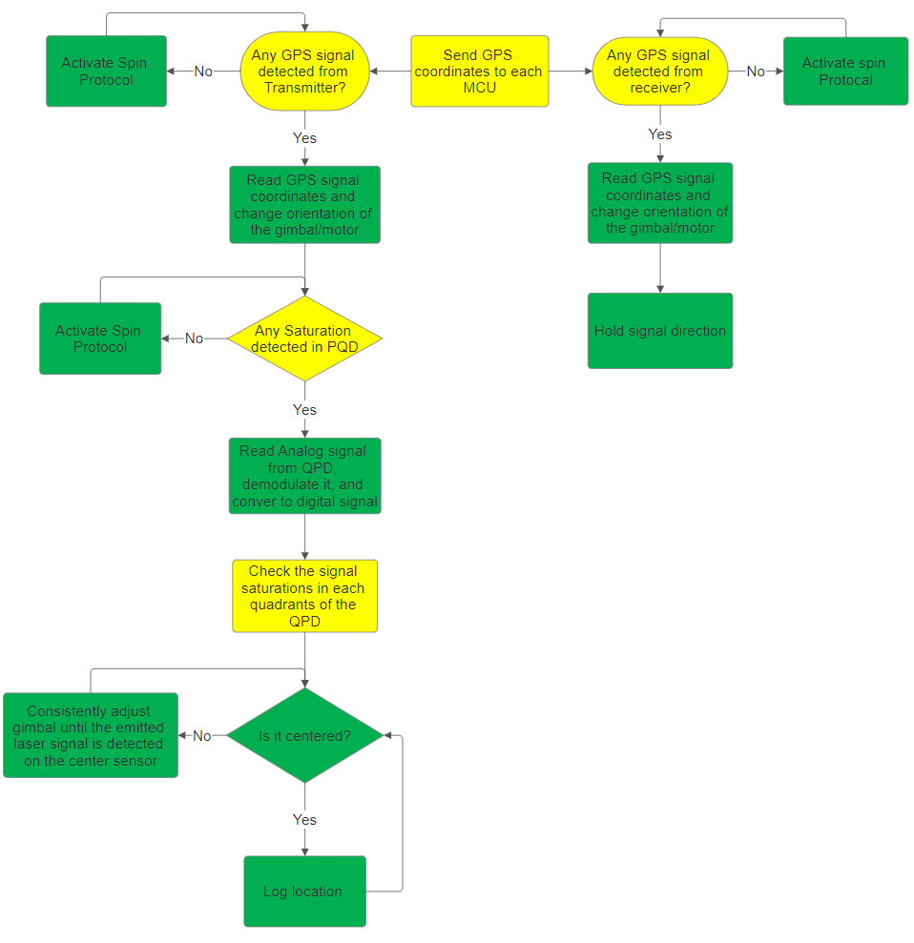
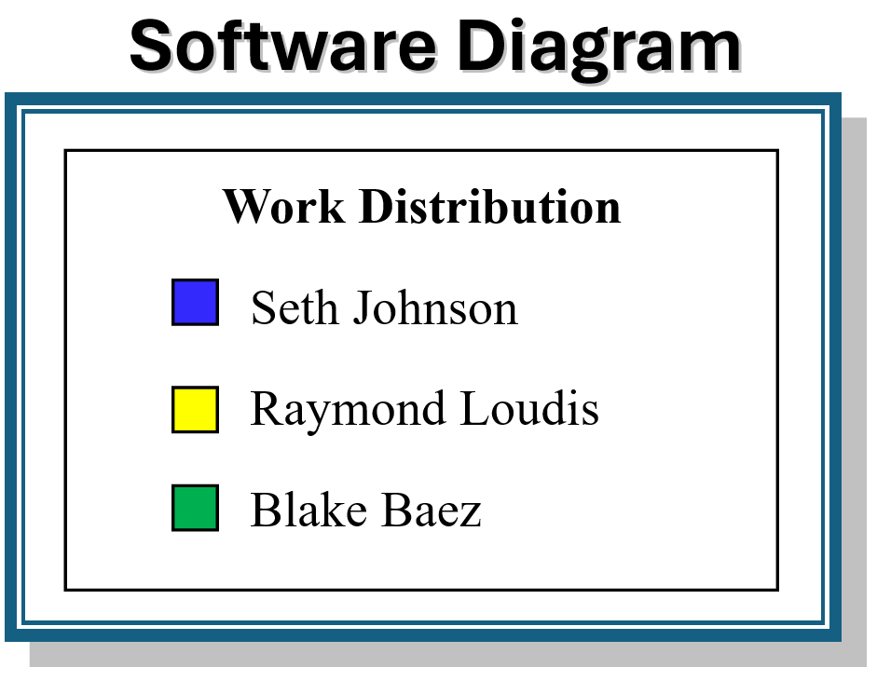
Software Diagram

Slide 38
Programming Language
 | C | Java | Python | C++
Imperative procedural language | Yes | No | No | No
Embedded Systems support | Great support. Nearly all microcontrollers can use c | Second most used language. Needs proper setup to communicate with hardware | Very little outside Raspberry Pi | Very little
Performance | High | Slower than c due to JVM | Slow | High
Memory Control | Low-level | Automated | Automated | Low-level

Slide 39
Communication Protocols
 | I2C | UART
Type | Synchronous (clocked) | Asynchronous (no clock)
Wiring (other than GND and power) | 2 (SDA, SCL) | 2 (TX, RX)
Devices supported | Multi-master, multi-slave | Point-to-point (can be expanded with hardware)
Use cases | Sensors, memory devices, displays | communication with peripherals, embedded devices, and pc
Complexity | More complex, requires addressing | Simple, but point-to-point only

Slide 40
Key Concepts in Algorithms and Systems Control
Search Algorithm
  For finding any signal
Alignment Algorithm
  For establishing a signal from the laser diode
Control Theory
Signal Processing

Slide 41
Alignment Algorithm
Conical Alignment: involves adjusting the alignment of two systems or components by rotating one of them around an axis in a conical pattern until optimal alignment is achieved.
Radial Alignment: involves moving or adjusting the alignment of a system radially outward or inward from a central point, typically along straight lines in different directions

Slide 42
Alignment Algorithm
 | Conical | Radial
Adjustment | continuous circular motion allows for small, precise adjustments | radial alignment only covers specific directions, potentially missing the best alignment
Complexity | Can be complex depending | Simple
Coverage | Covers a wide area (all angles) | Limited

Slide 43
Search Algorithm
Golden Section Search: Starts with an interval and evaluates the function at two points within the interval, spaced according to the golden ratio; then shrink the interval to discard the suboptimal side.
Spiral Search: Searches for the optimum by moving in an outward or inward spiral pattern from a central point.
 | Golden Section Search | Spiral Search
Efficiency | Very efficient; uses golden ratio to minimize the number of function evaluations | Inefficient for precis searches; it can require many function evaluations
Convergence Guarantee | guarantees convergence to the minimum for unimodal functions. | no guaranteed convergence to a minimum
Complexity | Not very complex | Can be computationally expensive

Slide 44
Control Theory
Kalman Filter: a mathematical algorithm used to estimate the state of a dynamic system from noisy measurements.
  Useful in sensor fusion where data from multiple sources need to be combined
  Useful in systems that require real-time tracking
  Can be used to predict the next state of the transmitter/receiver
  Can be complex for non-linear models
  Requires tuning

Slide 45
Signal Processing
Interpolation: refers to estimating intermediate values between discrete data points in a signal, often to increase the signal's sampling rate or improve its resolution.
    Improves signal quality
    Can correct timing errors
    Up sampling or Down-sampling
    Ensures efficient data recovery

Slide 46
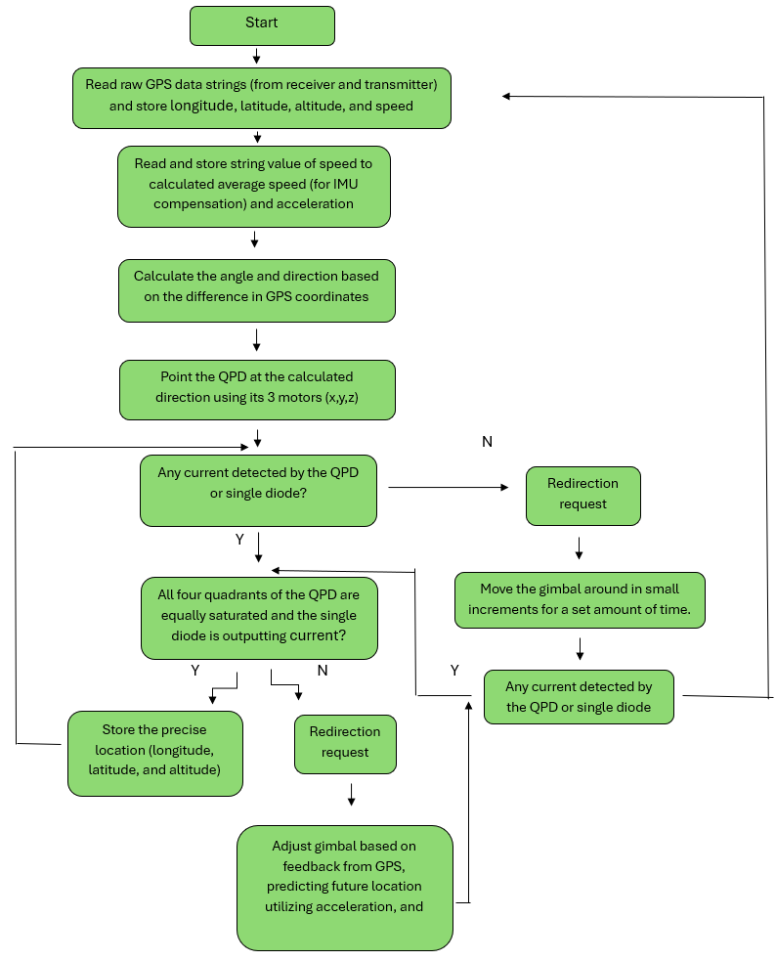
Receiver sequence diagram

Slide 47
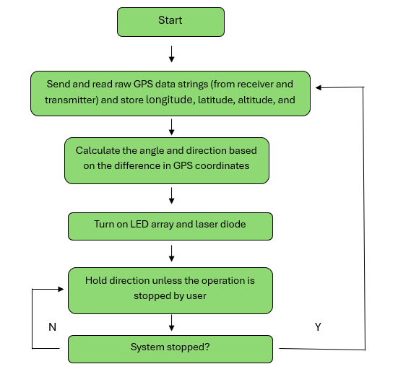
Transmitter sequence diagram

Slide 48
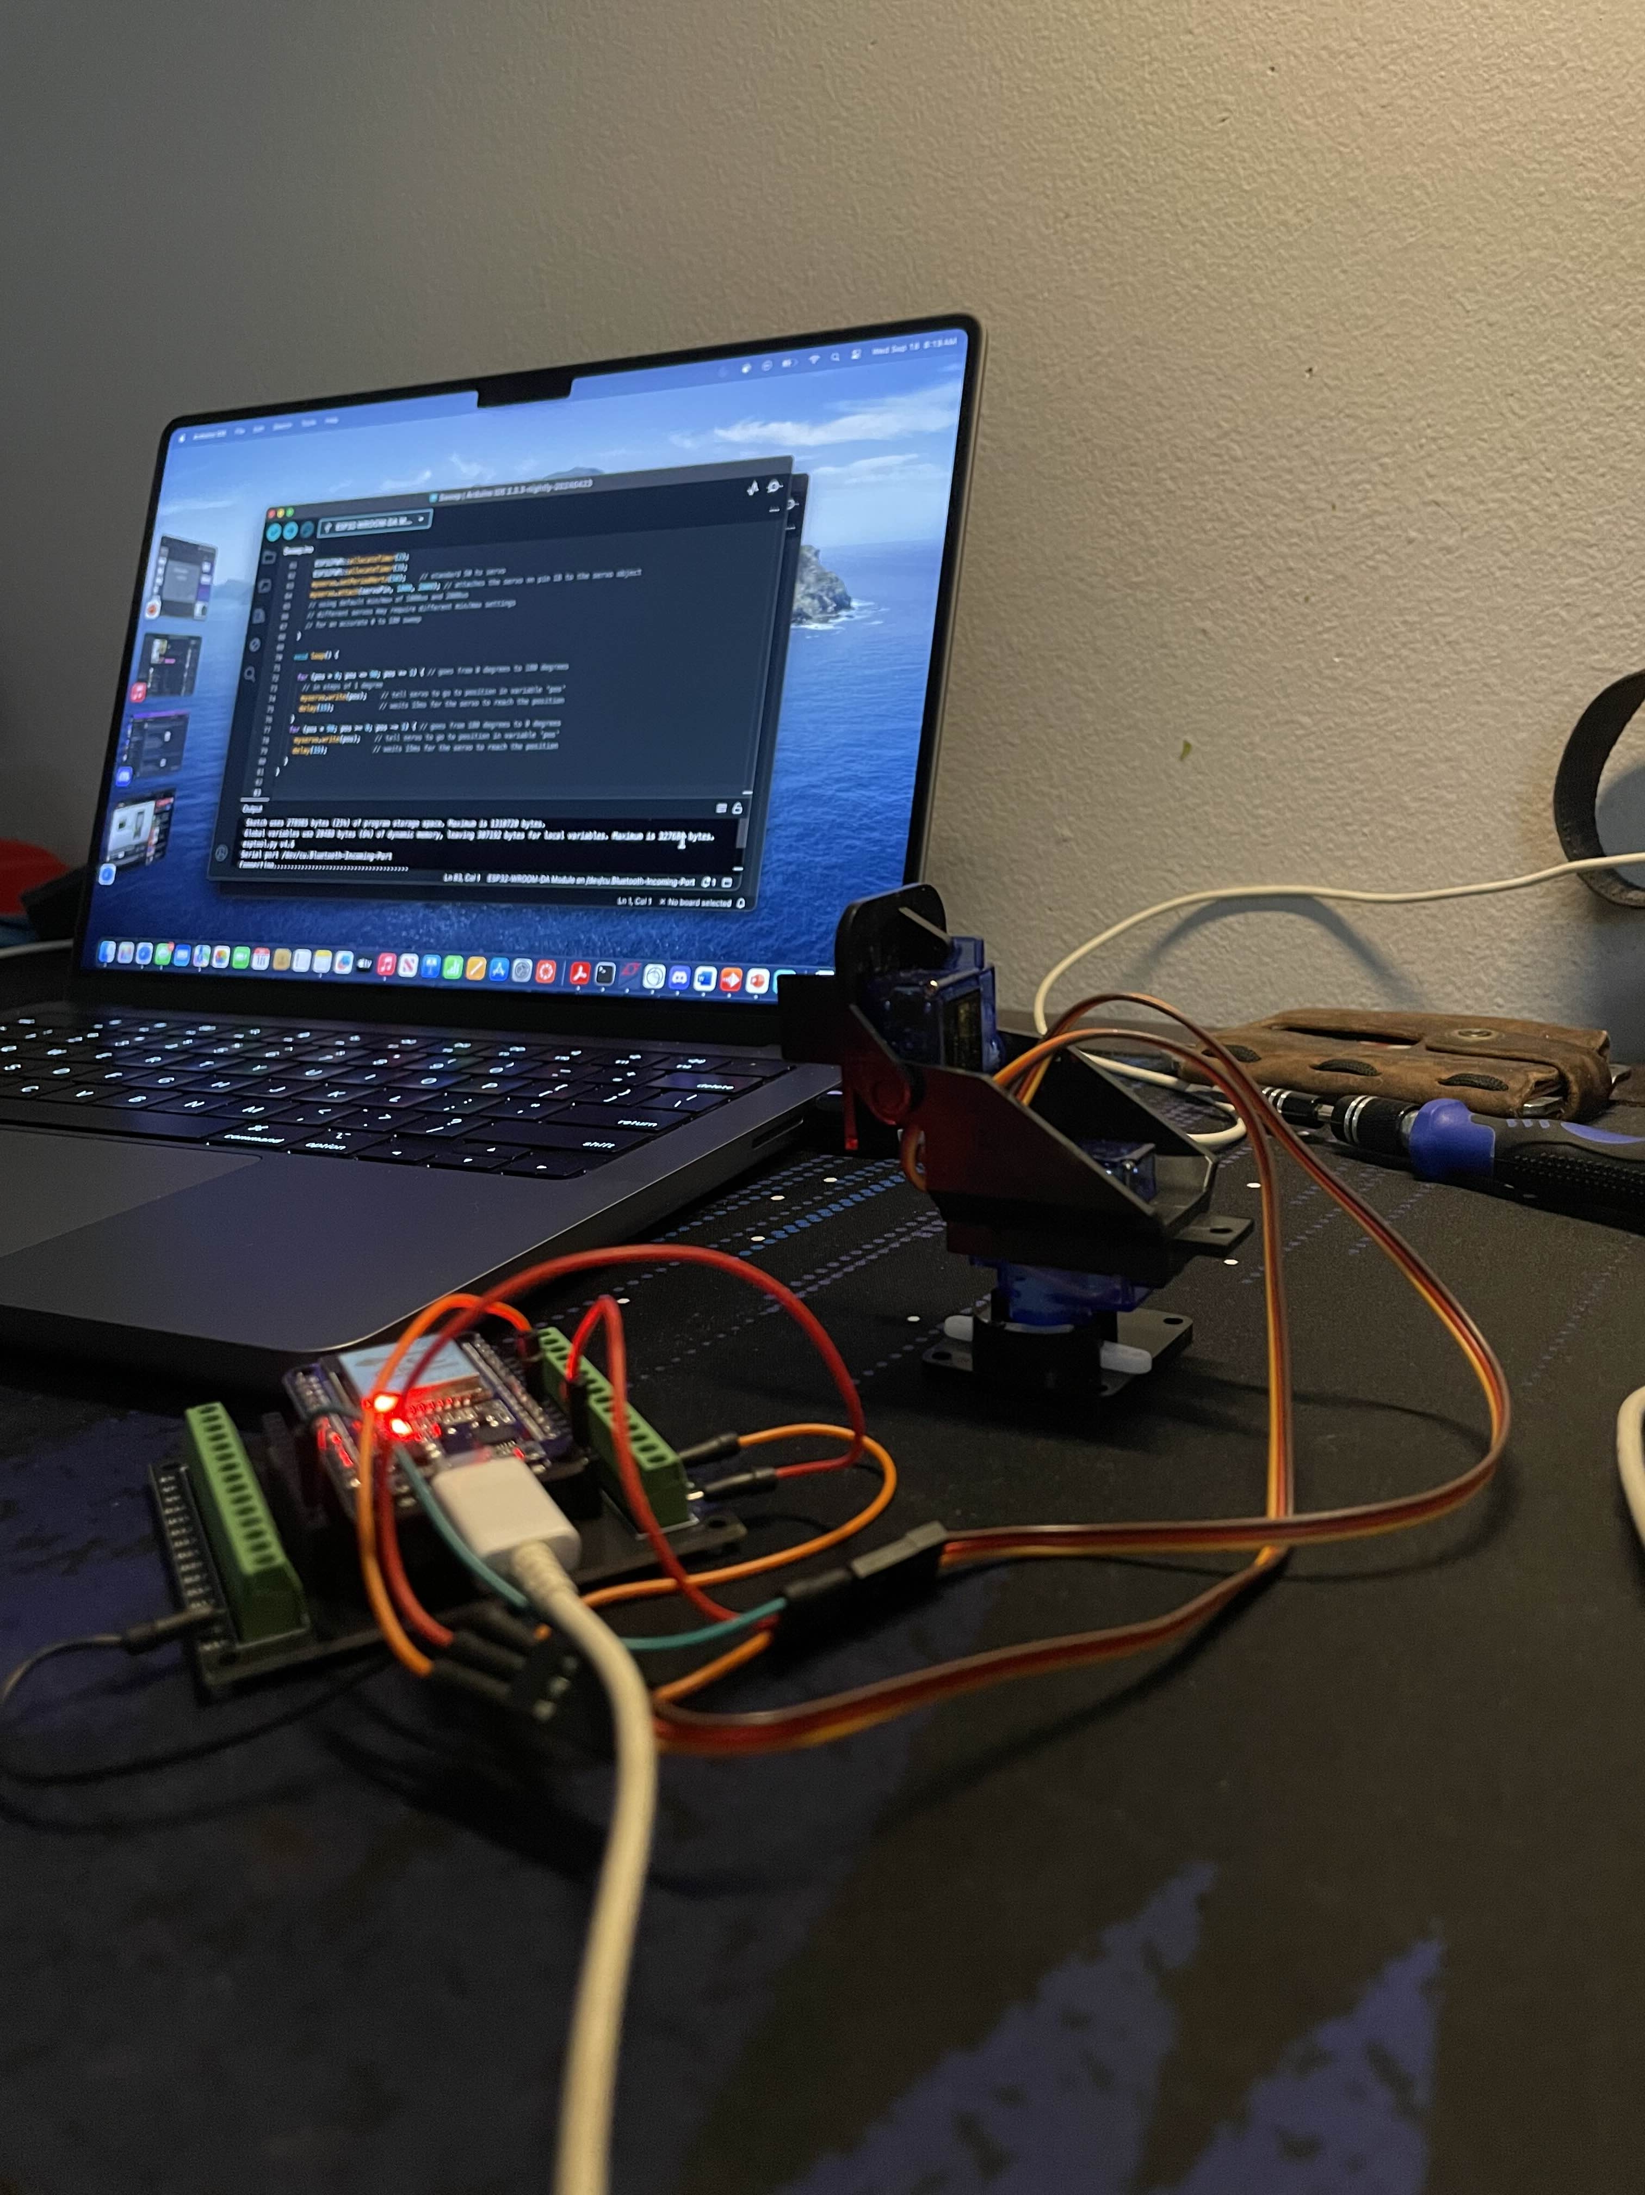
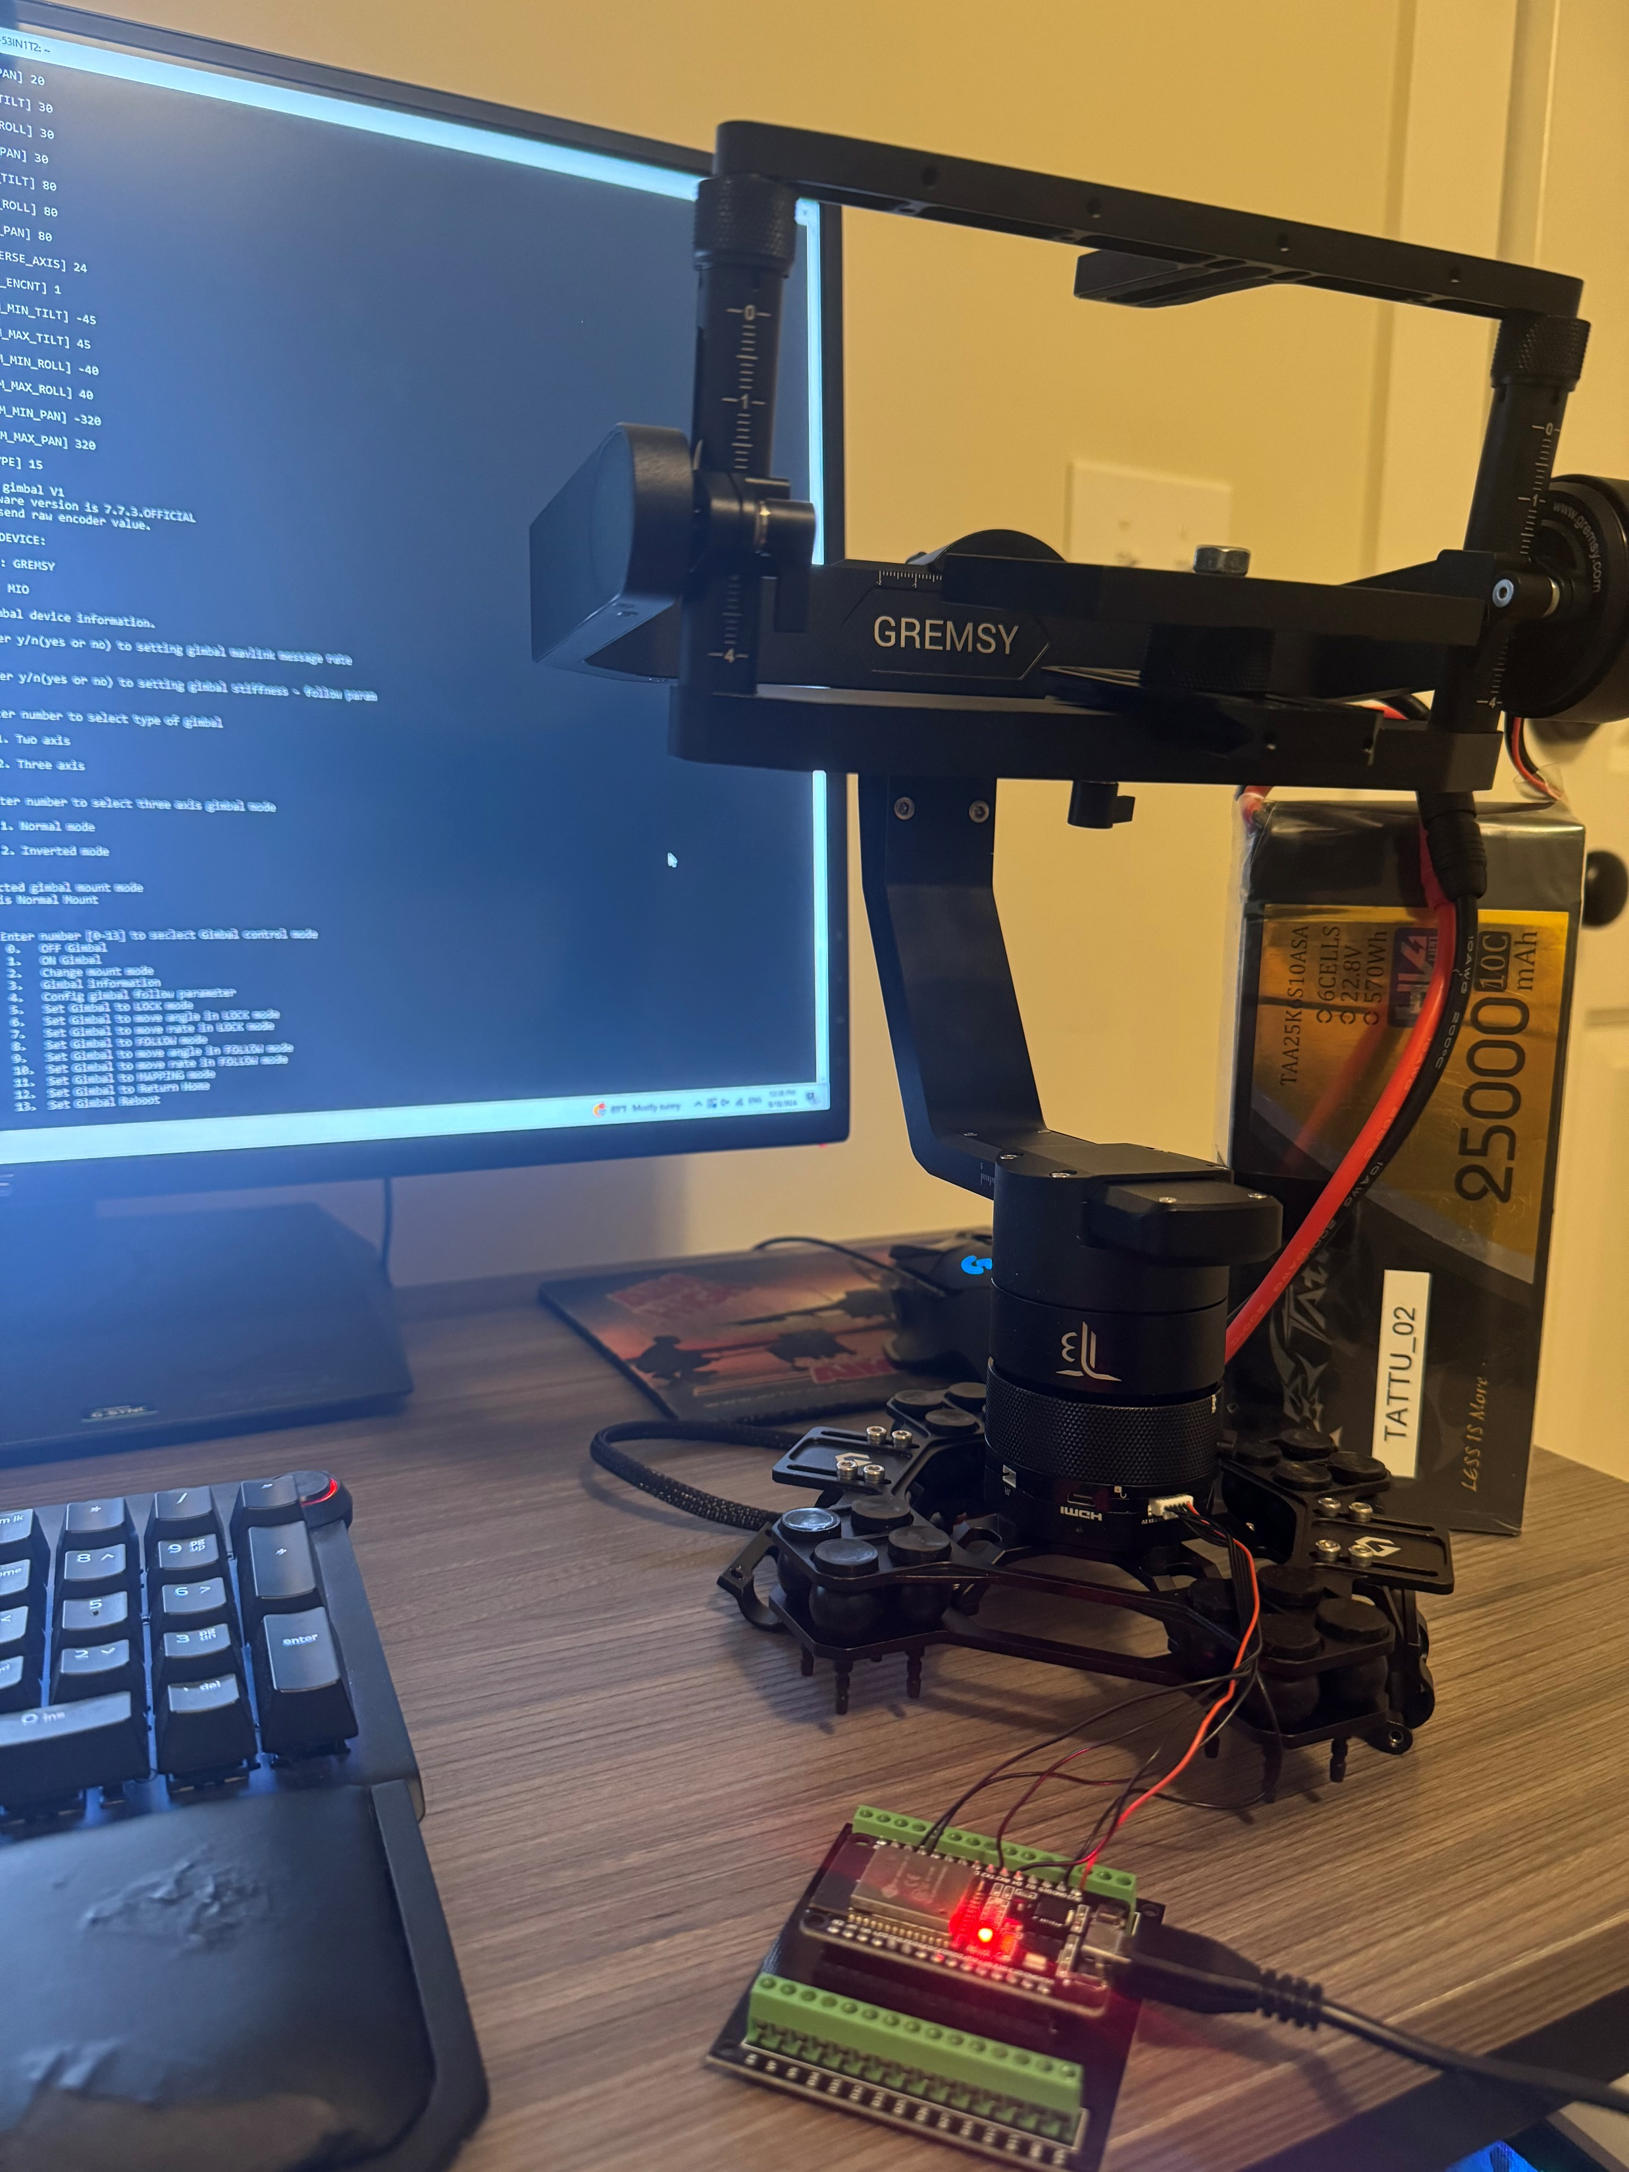
Testing the Gimbal & Motor

Slide 49
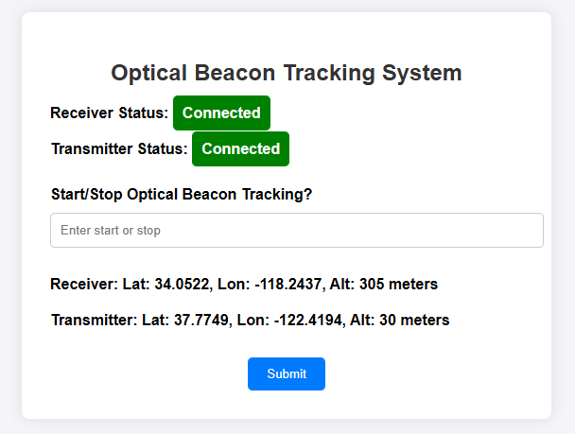
Graphic User Interface

Slide 50
Budget
The KVL group has donated a few pieces of equipment, such as the Gremzy T3V3, as well as a budget of $5000 for other items we might need
All experimental equipment, such as the THT LEDs that will not be used in the final project, are paid for by the group members

Slide 51
Expenses (as of 9/13/2024)
Item | Quantity | Unit Cost | Total Cost | Acquisition Status
SFH 4258S 850nm LED | 25 | $1.10 | $27.5 | Acquired
CVLL 95-50 1550nm LD | 1 | $240 | $240 | Acquired
SPOT-9D-0 Annular QPD | 1 | $150 | $150 | Acquired
FGA01FC InGaAs PD | 1 | $175 | $175 | Acquired
NIR coated Optical Lenses | 4 | $43 | $172 | Acquired
ED1-C20 Optical Diffuser | 1 | $142.56 | $142.56 | Acquired
87-040 Dichroic Mirror | 1 | $176 | $176 | Acquired
Gremsy T3V3 Receiver Gimbal | 1 | $1800 | $1800 | Acquired*
Feiyu G6 Max Beacon Motor | 2 | $190 | $280 | Acquired
Here3+ GPS Module | 1 | $350 | $350 | Acquired
Cube Orange+ IMU Module | 1 | $350 | $350 | Acquired
ESP32 MCU Module | 1 | $45 | $45 | Acquired
RDX900x-US LoRa Modules | 2 | $96 | $192 | Acquired
Tattu Batteries | 2 | $405 | $810 | Acquired
Beacon PCB | 1 | $37.13 | $37.13 | Ordered
Receiver PCB | 1 | $42.33 | $42.33 | Ordered
PCB components | N/A | N/A | $40-60 | Ordered
Cost to Date |  |  | $
*donated by the KVL group

Slide 52
Work distribution
Seth Johnson
Optical design
Optoelectronic hardware selection
Physically assembling the beacon and receiver with Raymond
Blake Baez
Software design
MCU and GPS selection
Designing and maintaining the website
Raymond Loudis
Electrical/PCB design
Electrical hardware selection
Physically assembling the beacon and receiver with Seth

Slide 53
Plan moving forward
We currently possess almost all our hardware, however we are still waiting on our PCBs to arrive.
By 10/16 we will have tested our first PCB and have the beacon operational.
Also by 10/16 we will also be able to control the gimbal using inputs from the GPS and photodiodes.

